Slide 1


Andrew B
10/6/2022

Slide 2

Outline
Executive Summary
Introduction
Methodology
Results
Conclusion
Appendix

Slide 3
Executive Summary
Summary of methodologies
API and Web Scraping
• Data Wrangling
• EDA
• Analyze Successful Orbits
• SQL Database Analysis
• Visual Analysis
• Predictive Analysis with Logistic Regression, SVM, Decision Tree, KNN
Summary of all results
Launch success
Success over time
Possibly Future Rate of Success

Slide 4
Introduction
SpaceY has presented an incredible opportunity to revolutionize space travel with reusable rockets.
The purpose of the findings here are to see if we can accurately predict the rate of successful landings that result in a reusable rocket.

Slide 5

Section 1

Slide 6
Methodology
Executive Summary
Data collection methodology:
Data was gathered via api calls and web scraping with Beautiful Soup.
Perform data wrangling
Data was processed and formatted using SQL, pandas and other data science tools.
Perform exploratory data analysis (EDA) using visualization and SQL
Perform interactive visual analytics using Folium and Plotly Dash
Perform predictive analysis using classification models
Predictive analysis was performed with a high success rate with logistic regression and SVM. Data was tuned using sklearn and train_test_split to train the algorithms.

Slide 7
Data Collection
Our data sets were gathered using API calls and Beautiful Soup for web scraping.
An API call is made and a file containing data in json format is returned.
API Call
User
SpaceY Servers
json file

Slide 8
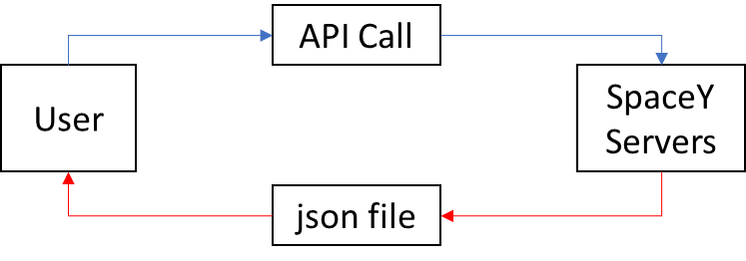
Data Collection – SpaceX API
An API call is made and a file containing data in json format is returned.
https://github.com/andros814/API-Calls.git

Slide 9
Data Collection - Scraping
BeautifulSoup is used to read the SpaceY website and return specific information.
https://github.com/andros814/Web-Scraping.git
Soup request
User
SpaceY Website
json file

Slide 10
Data Wrangling
After the data was gathered it was analyzed to show the current success rate of landings as well as the factors that went into making them successful landings.
https://github.com/andros814/Data-Wrangling.git
Average the current success rate
Data
Analysis of Landings
Remove NaN Values
Reformat the Table

Slide 11
EDA with Data Visualization
CatPlots were used to show the relationship between flight number and pay load mass. These variables were then further compared to attributes such as orbit type and launch site to gain an understanding behind the current success rate.
https://github.com/andros814/Data-Visulization.git

Slide 12
EDA with SQL
The distinct launch sites were found in the data
The first five launch sites beginning with ‘CCA’ were found in the data
NASA (CRS)’s total payload was found in the data
The average payload mass carried by booster F9 v1.1 was shown
The date of the first successful landing was shown.
The best boosters for landing on drone ships were shown
The total number of successful and unsuccessful missions was shown
The boosters that can carry heavy loads were shown
The worst boosters for landing on drones in 2015 were shown
All result of all attempted landings for 2011-06 to 2017-03 were shown
https://github.com/andros814/EDA-with-SQL.git

Slide 13
Build an Interactive Map with Folium
Map markers and lines were used to show the locations of SpaceY launch facilities and give an idea of where some success and failures were originating from.
The added objects also showed the proximity of towns, railroads and highways for material and people resources and transportation.
https://github.com/andros814/Folium-Maps.git

Slide 14
Build a Dashboard with Plotly Dash
Graphs, pie charts and scatter plots have been used to convey the findings to users in an attainable way.
These plots were all used for their ease of comprehension and accuracy of data.
https://github.com/andros814/Plotly-Dash.git

Slide 15
Predictive Analysis (Classification)
A few different models were built and tested to process the data and see which models truly resulted in an accurate outcome
You need present your model development process using key phrases and flowchart
https://github.com/andros814/predictive-analysis.git

Slide 16
Results
Exploratory data analysis results
Interactive analytics demo in screenshots
Predictive analysis results

Slide 17

Section 2

Slide 18
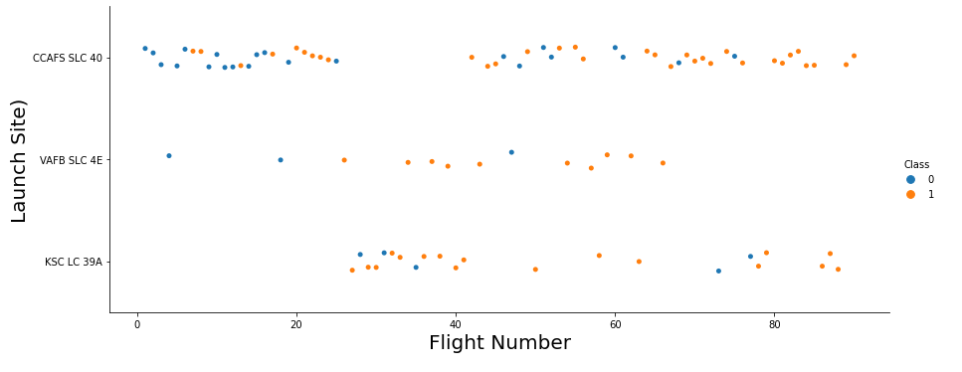
Flight Number vs. Launch Site
A scatter plot showing which flights depart from which launch site

Slide 19
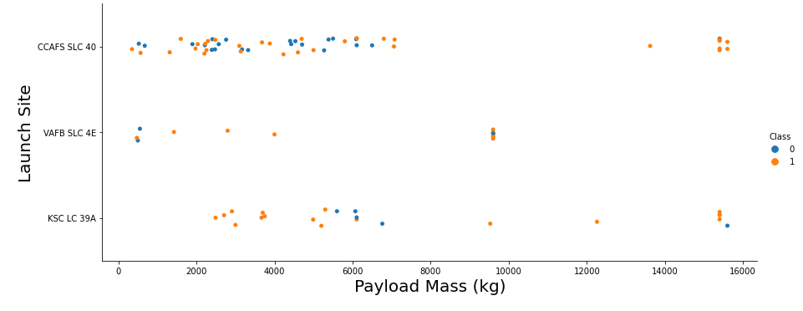
Payload vs. Launch Site
A visual representation of how much payload goes through each launch site

Slide 20
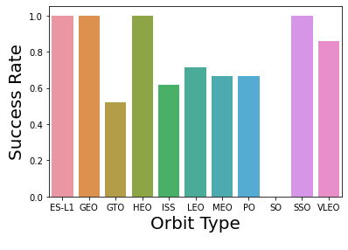
Success Rate vs. Orbit Type
Proof of which orbits perform successfully.

Slide 21
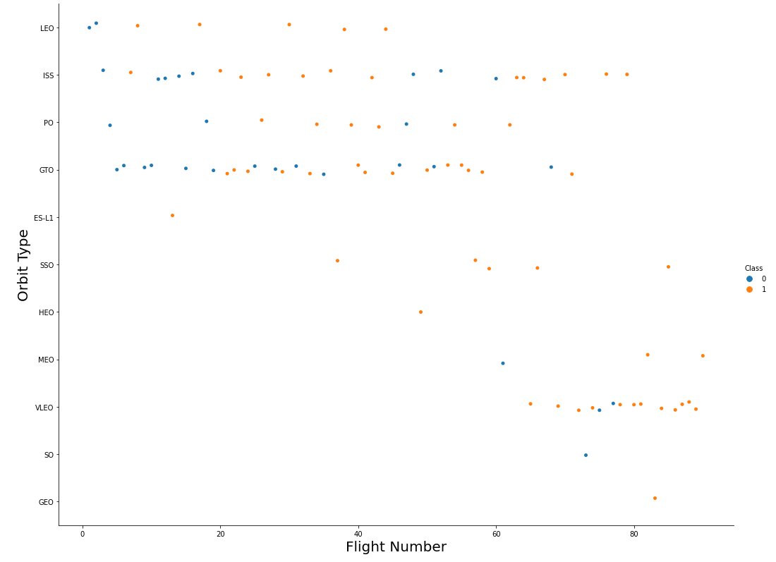
Flight Number vs. Orbit Type
Tracking of which flight numbers and the amount of flights that operate in each orbit

Slide 22
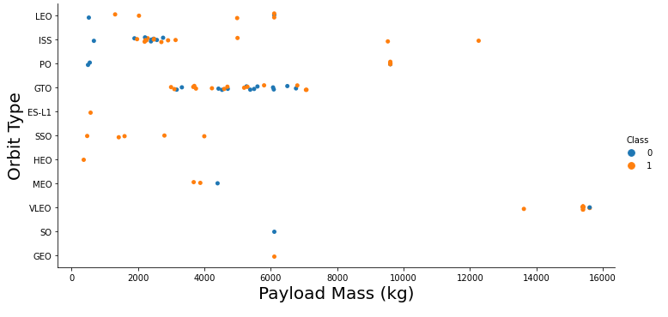
Payload vs. Orbit Type
Visual representation of where our larger and smaller payloads are going

Slide 23
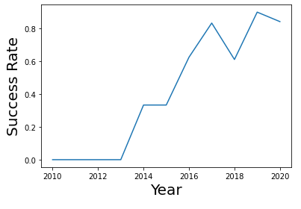
Launch Success Yearly Trend
This plot clearly represent the climbing success rate as hardware and software improve

Slide 24
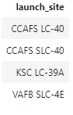
All Launch Site Names
Our Launch sites as produced with an SQL query

Slide 25
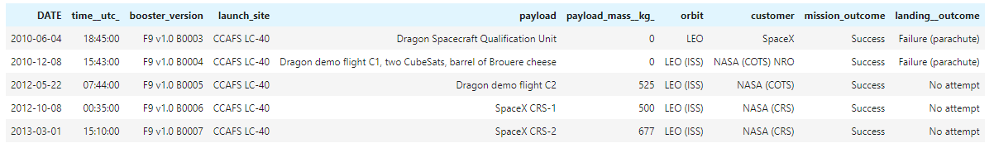
Launch Site Names Begin with 'CCA'
A brief look at launch sites designated ‘CCA’

Slide 26
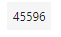
Total Payload Mass
Business with NASA (CRS) is good. We have launched a substantial amount of their materials into orbit

Slide 27
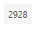
Average Payload Mass by F9 v1.1
The F9 v1.1 has not been hauling large payloads

Slide 28

First Successful Ground Landing Date
The day of our first successful landing

Slide 29
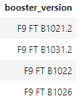
Successful Drone Ship Landing with Payload between 4000 and 6000
Have proven to be successful heavy haulers and landers

Slide 30

Total Number of Successful and Failure Mission Outcomes
Total missions to date

Slide 31
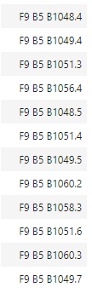
Boosters Carried Maximum Payload
The boosters which haul our heaviest payloads

Slide 32
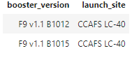
2015 Launch Records
Our failed landings in 2015 by booster type

Slide 33
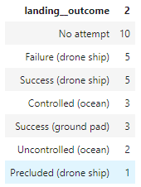
Rank Landing Outcomes Between 2010-06-04 and 2017-03-20
Our landings from 2011-06-04 to 2017-03-20

Slide 34

Section 3

Slide 35
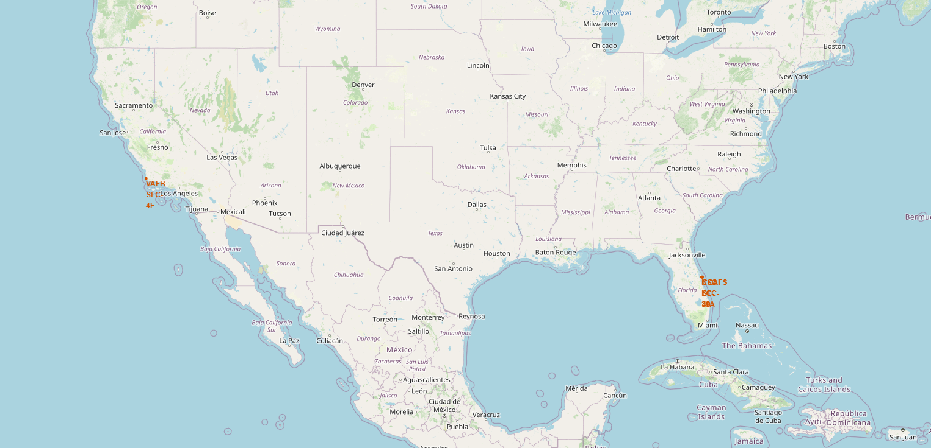
Our Launch Sites
Our Launch Sites
Showing us firmly seated with NASA and able to take advantage of their infrastructure

Slide 36
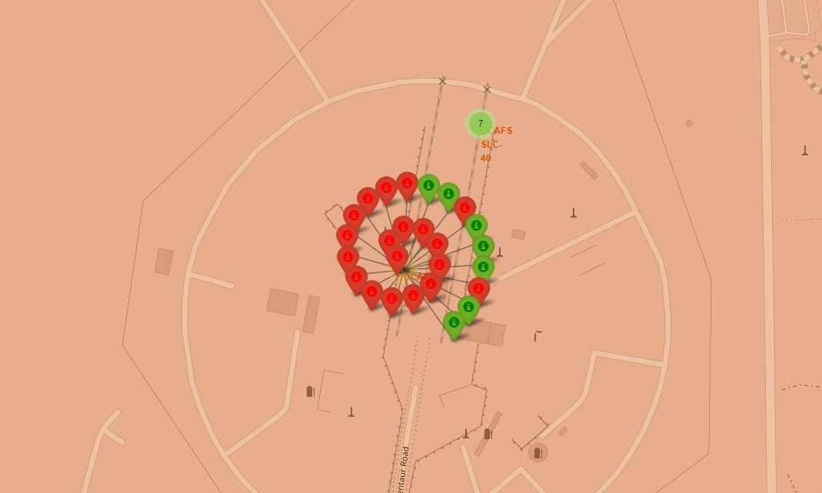
Our Florida Facility
Our Florida Facility
Green represents our successful flights from this location and red, our failures.

Slide 37
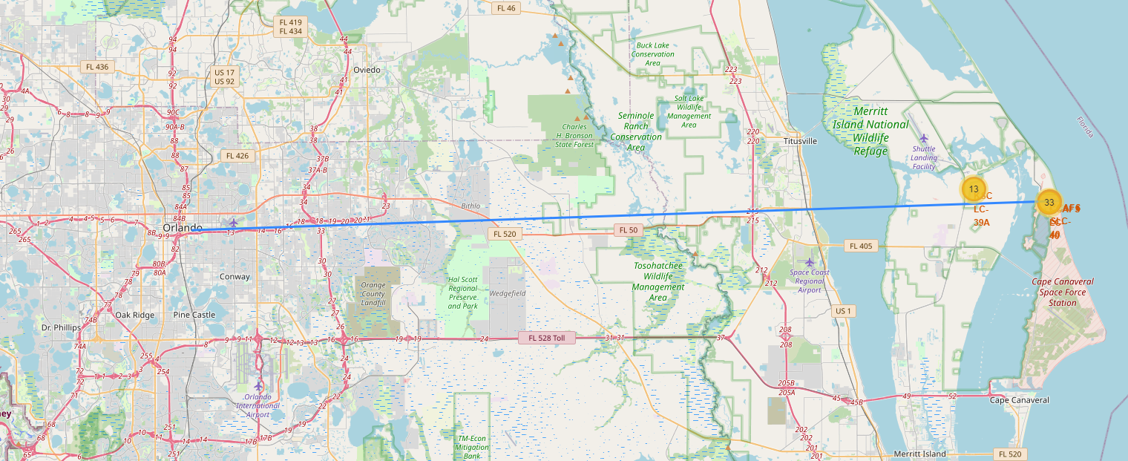
Proximity to Resources
Proximity to Resources
Our ease of access to Orlando and Disney World

Slide 38

Section 4

Slide 39
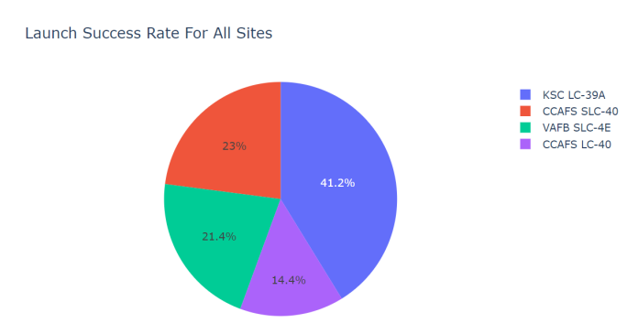
Launch Site Success
Success measured by launch site

Slide 40
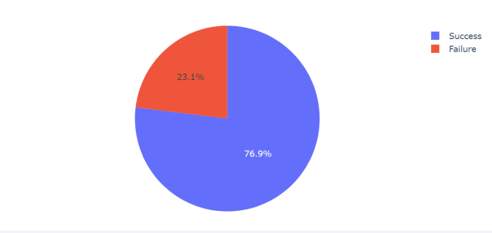
Kennedy – Our most successful launch site
The majority of our successful launches have been at Kennedy

Slide 41
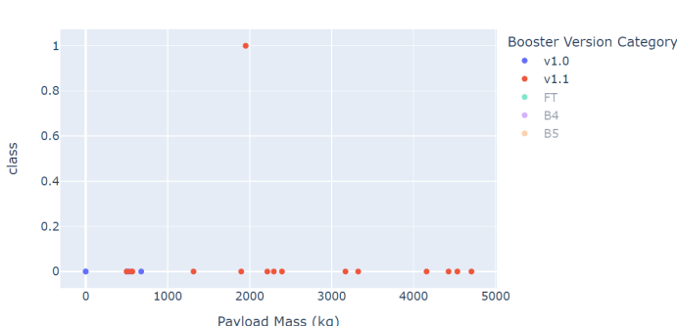
Booster Success Rates
Our boosters are expensive and need to be precise

Slide 42

Section 5

Slide 43
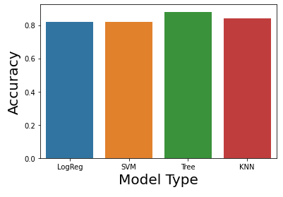
Classification Accuracy

Slide 44
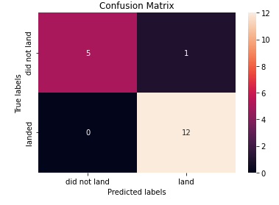
Confusion Matrix
A decision Tree came away with the best predication by showing where our stronger launch sites and boosters were.

Slide 45
Conclusions
Space travel and rocket landings are getting safer and more frequent leading to cost effective space travel.

Slide 46
Appendix
I’d like to thank my cat for hearing my long winded explanations of concepts to improve my own understanding

Slide 47


